Slide 1
PYCON - India
Hyderabad,2023
Optimising IPC (Inter Processor Communication)
https://www.geeksforgeeks.org/inter-process-communication-ipc/

Slide 2
IPC Methods
Shared Memory
Batch processing
Sockets
RPC
M Map

Slide 3
Shared Memory Key points
Cannot Handle a large object
Multiple copies
Pickling
The Shared memory process Bugs are implementing

Slide 4
Shared Memory
Shared memory is a faster inter process communication system. It allows cooperating processes to access the same pieces of data concurrently.
It speeds up the computation power of the system and divides long tasks into smaller sub-tasks and can be executed in parallel.

Slide 5
Sockets
This Method is mostly used to communicate over a Network between a client and server.
It allows for a standard connection which is computer and os independent

Slide 6
M Map
This module does not work or is not available on WebAssembly platforms wasm32-emscripten and wasm32-wasi. See WebAssembly platforms for more information.
Memory-mapped file objects behave like both bytearray and like file objects. You can use mmap objects in most places where bytearray are expected; for example, you can use the re module to search through a memory-mapped file. You can also change a single byte by doing obj[index] = 97, or change a subsequence by assigning to a slice: obj[i1:i2] = b'...'. You can also read and write data starting at the current file position, and seek() through the file to different positions.
Read more

Slide 7
Zero -Copy
Zero-copy is a technique in computer programming that allows data to be transferred between different parts of a program without being copied to intermediate buffers. In Python, this technique can be achieved using the memory view object, which provides a view into the memory of other objects.
The ‘Zero Copy’ describes computer operations in which the CPU does not perform the task of copying data from one memory area to another or in which unnecessary data copies are avoided.
Read more

Slide 8
Robust API
Designing a robust REST API requires adherence to best practices to ensure scalability, maintainability, and ease of use. By following these guidelines and utilizing Python's powerful libraries and frameworks, you can create APIs that provide a seamless experience for both developers and end-users.
Read more

Slide 9
Fast API
It is very Fast
High performance
Easy to learn
Fast to code
Ready for production
It works on python 3.7 + versions
Fever nugs reduce about 40% of human induced errors

Slide 10
Build a Healthcare Plartform
Collect data form a Hospitals
Store a data from a AWS(Amazon Web Services)
Mata Data is store by the Mango DB
Use a OLAP(Online Analytical processing)

Slide 11

AWS
AWS is designed to allow application providers, ISVs, and vendors to quickly and securely host your applications – whether an existing application or a new SaaS-based application. You can use the AWS Management Console or well-documented web services APIs to access AWS's application hosting platform.

Slide 12

Azure
Azure is a public cloud computing platform—with solutions including Infrastructure as a Service (IaaS), Platform as a Service (PaaS), and Software as a Service (SaaS) that can be used for services such as analytics, virtual computing, storage, networking, and much more.

Slide 13
OLTP
OLTP or Online Transaction Processing is a type of data processing that consists of executing a number of transactions occurring concurrently—online banking, shopping, order entry, or sending text messages, for example.
Read more

Slide 14
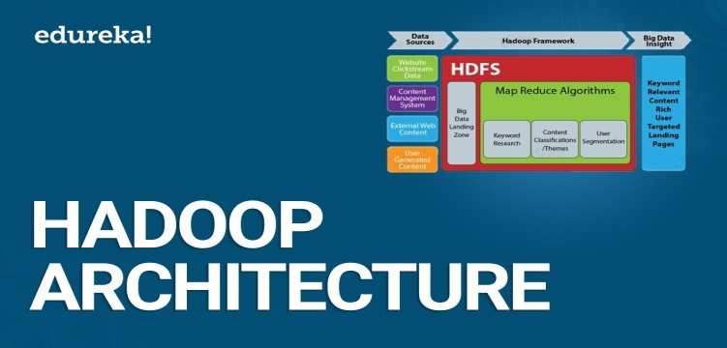
HADOOP
As we all know Hadoop is a framework written in Java that utilizes a large cluster of commodity hardware to maintain and store big size data. Hadoop works on MapReduce Programming Algorithm that was introduced by Google. Today lots of Big Brand Companies are using Hadoop in their Organization to deal with big data, eg. Facebook, Yahoo, Netflix, eBay, etc. The Hadoop Architecture Mainly consists of 4 components.
MapReduce
HDFS(Hadoop Distributed File System)
YARN(Yet Another Resource Negotiator)
Common Utilities or Hadoop Common

Slide 15
Snowflake
Snowflake enables data storage, processing, and analytic solutions that are faster, easier to use, and far more flexible than traditional offerings. The Snowflake data platform is not built on any existing database technology or “big data” software platforms such as Hadoop.
Read more

